Slide 1
Google Play Store: App Permission Analytics
Prajit Kumar DaS
Advised by: Dr. Anupam Joshi
In collaboration with: Drs. Nilanjan Banerjee, Ryan Robucci

Slide 2
Data collection stats
According to AppBrain
Current number of Android apps in the market: 1,660,965 (as on August 24, 2015)
54 App categories including Medical and Health & Fitness
49,024 Health & Fitness Apps and 25,034 Medical Apps
App data collected
Total app data collected: 1,305,103
48,231 Health & Fitness Apps and 23,855 Medical Apps
Does not reflect app permission info
Total number of apps whose permissions have been collected: 933,480
26,248 Health & Fitness Apps and 14,247 Medical Apps

Slide 3
A bit more stats
Apps request
235,869 unique permissions
Top 20 requested permissions are shown
Number of apps requesting permission | Permission Name
859199 | android.permission.INTERNET
726725 | android.permission.ACCESS_NETWORK_STATE
560329 | android.permission.READ_EXTERNAL_STORAGE
557428 | android.permission.WRITE_EXTERNAL_STORAGE
346285 | android.permission.READ_PHONE_STATE
294205 | android.permission.WAKE_LOCK
263031 | android.permission.ACCESS_FINE_LOCATION
247873 | android.permission.ACCESS_WIFI_STATE
237815 | android.permission.ACCESS_COARSE_LOCATION
234052 | android.permission.VIBRATE
194944 | android.permission.GET_ACCOUNTS
193073 | com.google.android.c2dm.permission.RECEIVE
152209 | android.permission.CAMERA
103478 | android.permission.CALL_PHONE
93749 | android.permission.RECEIVE_BOOT_COMPLETED
77515 | android.permission.RECORD_AUDIO

Slide 4
A bit more stats
Top 20 requested permissions by
Healthcare apps
Number of apps requesting permission | Permission Name
24600 | android.permission.INTERNET
20506 | android.permission.ACCESS_NETWORK_STATE
15240 | android.permission.READ_EXTERNAL_STORAGE
15203 | android.permission.WRITE_EXTERNAL_STORAGE
9164 | android.permission.READ_PHONE_STATE
8986 | android.permission.ACCESS_FINE_LOCATION
8462 | android.permission.WAKE_LOCK
8163 | android.permission.ACCESS_COARSE_LOCATION
7694 | android.permission.VIBRATE
7439 | com.google.android.c2dm.permission.RECEIVE
7107 | android.permission.GET_ACCOUNTS
5293 | android.permission.ACCESS_WIFI_STATE
5062 | android.permission.CAMERA
3809 | android.permission.CALL_PHONE
3210 | android.permission.RECORD_AUDIO
2578 | android.permission.RECEIVE_BOOT_COMPLETED

Slide 5
A bit more stats
Top 20 requested permissions by
Medical apps
Number of apps requesting permission | Permission Name
13484 | android.permission.INTERNET
11198 | android.permission.ACCESS_NETWORK_STATE
8393 | android.permission.READ_EXTERNAL_STORAGE
8367 | android.permission.WRITE_EXTERNAL_STORAGE
4477 | android.permission.READ_PHONE_STATE
4191 | android.permission.ACCESS_FINE_LOCATION
4164 | com.google.android.c2dm.permission.RECEIVE
4036 | android.permission.GET_ACCOUNTS
3930 | android.permission.WAKE_LOCK
3821 | android.permission.ACCESS_COARSE_LOCATION
3694 | android.permission.VIBRATE
2765 | android.permission.ACCESS_WIFI_STATE
2688 | android.permission.CAMERA
2436 | android.permission.CALL_PHONE
1551 | android.permission.RECEIVE_BOOT_COMPLETED
1545 | android.permission.RECORD_AUDIO

Slide 6
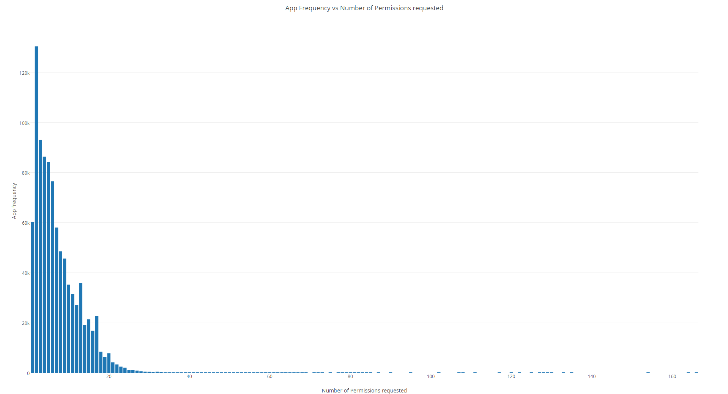
App frequency vs Permissions requested
App Package Nzame | Permissions Count
com.blinkbuddies.musicalbabymobile | 166
com.marthogames.muffinbutton | 164
com.jakkarrlgames.mathguru | 164
com.marthogames.starlander | 164
com.fuengfahsoft.grabtiles | 164
com.mwm.theball | 164
com.brainandheart.brainheart | 164
com.flyingcat.retroracing | 164
com.mwm.thequest | 164
com.cloudgames.snake2d | 164
com.jtwtw.god | 154
com.posstream.Monitor | 135
com.mls.updater | 133
com.luiseduardohd.nid.miqueridosanta | 130
com.team.angryballs | 129
com.team.halloweenslicer | 128
com.aqh.medways | 127
jp.ryosuke.matsuuchi.testpermissions | 127
com.webkey | 125
com.cloudshell | 125
com.eurotronik.inurse | 125

Slide 7
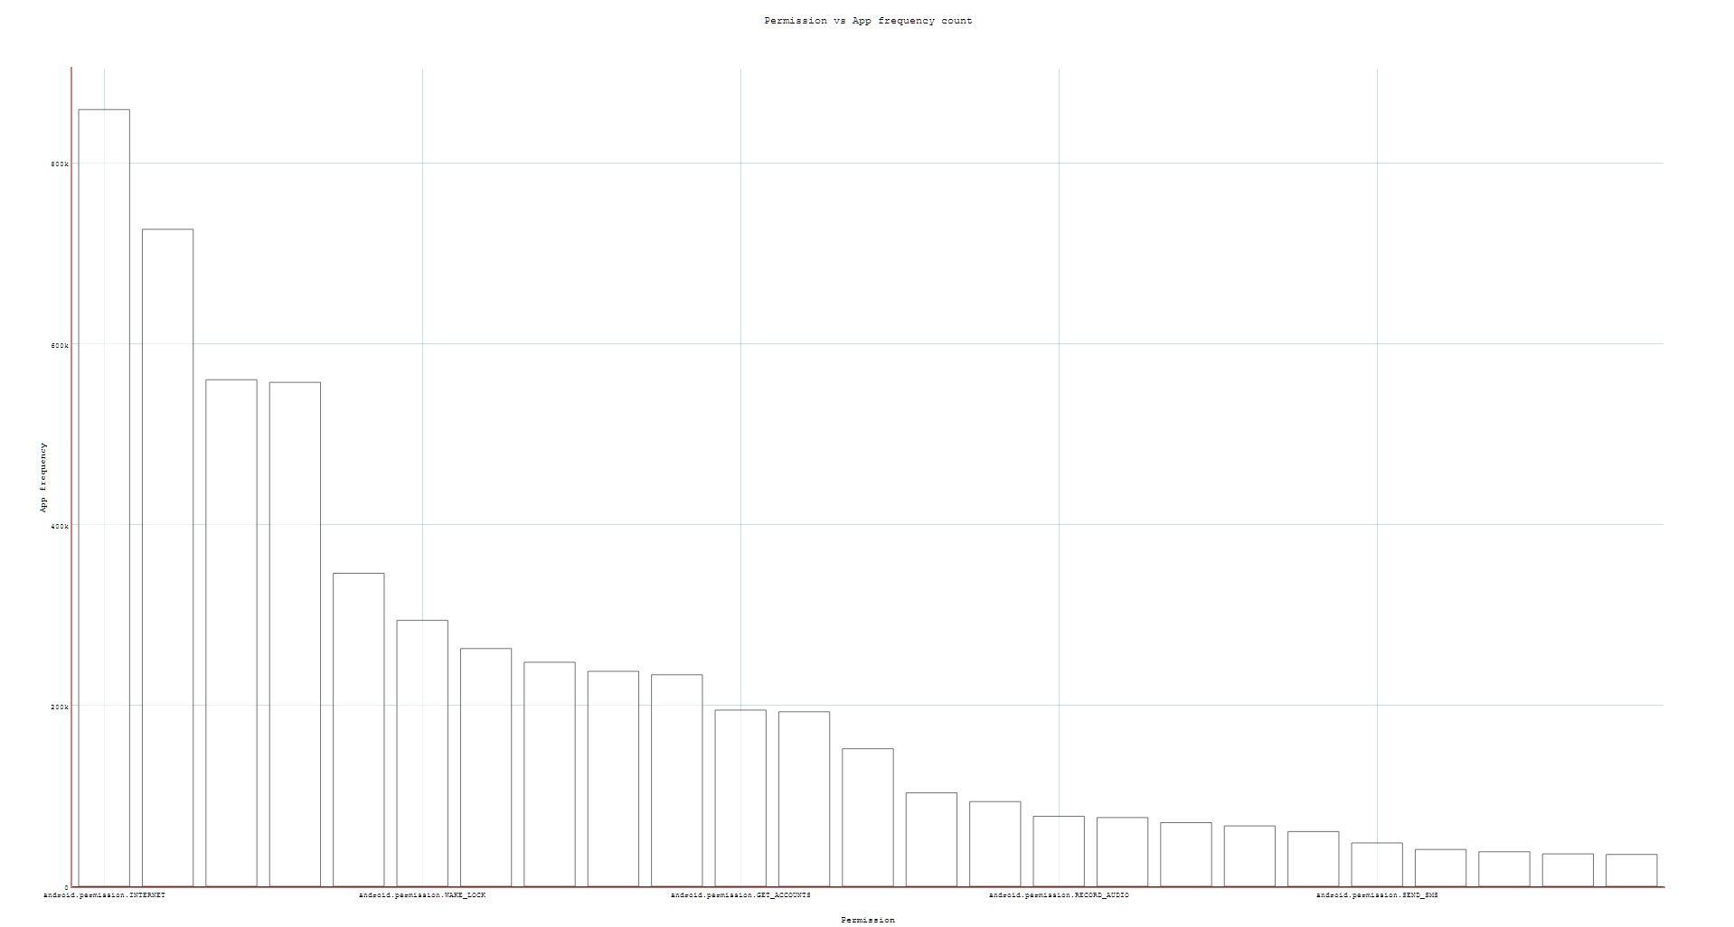
Top requested permissions
App Count | Permission Name
859199 | android.permission.INTERNET
726725 | android.permission.ACCESS_NETWORK_STATE
560329 | android.permission.READ_EXTERNAL_STORAGE
557428 | android.permission.WRITE_EXTERNAL_STORAGE
346285 | android.permission.READ_PHONE_STATE
294205 | android.permission.WAKE_LOCK
263031 | android.permission.ACCESS_FINE_LOCATION
247873 | android.permission.ACCESS_WIFI_STATE
237815 | android.permission.ACCESS_COARSE_LOCATION
234052 | android.permission.VIBRATE
194944 | android.permission.GET_ACCOUNTS
193073 | com.google.android.c2dm.permission.RECEIVE
152209 | android.permission.CAMERA
103478 | android.permission.CALL_PHONE
93749 | android.permission.RECEIVE_BOOT_COMPLETED
77515 | android.permission.RECORD_AUDIO
76072 | com.android.vending.BILLING
70459 | com.google.android.providers.gsf.permission.READ_GSERVICES
66856 | android.permission.READ_CONTACTS
60587 | android.permission.GET_TASKS
48008 | android.permission.SEND_SMS
40795 | com.android.vending.CHECK_LICENSE
38237 | android.permission.READ_CALL_LOG
35931 | android.permission.ACCESS_LOCATION_EXTRA_COMMANDS
35250 | android.permission.WRITE_CONTACTS

Slide 8
Cluster evaluation
Cluster evaluation measures:
External
Homogeneity Score: A clustering result satisfies homogeneity if all of its clusters contain only data points which are members of a single class. (Precision)
Completeness Score: A clustering result satisfies completeness if all the data points that are members of a given class are elements of the same cluster. (Recall)
Internal
Silhouette Coefficient : Calculated using the mean intra-cluster distance (a) and the mean nearest-cluster distance (b) for each sample as (b - a) / max(a, b).
Davies–Bouldin index (1974)
Dunn index (1973) Computes using the minimum distance between two clusters divided by the maximum mean distance between all points in clusters to their mean. This is computationally intensive with increasing number of clusters and dimensionality of data increase. It gives skewed results if one cluster is bad, sort of like a worst case indicator.

Slide 9
K-Means Clustering

Slide 10
K – Means: Process
Step 1: Transform an app to a vector rep by marking the permissions it requests
Step 2: Use vector as an input to K-Means clustering – Does app category become evident?
Step 3: In each cluster or category try to annotate outlier apps
Step 3: Outliers are flagged for static code analysis

Slide 11
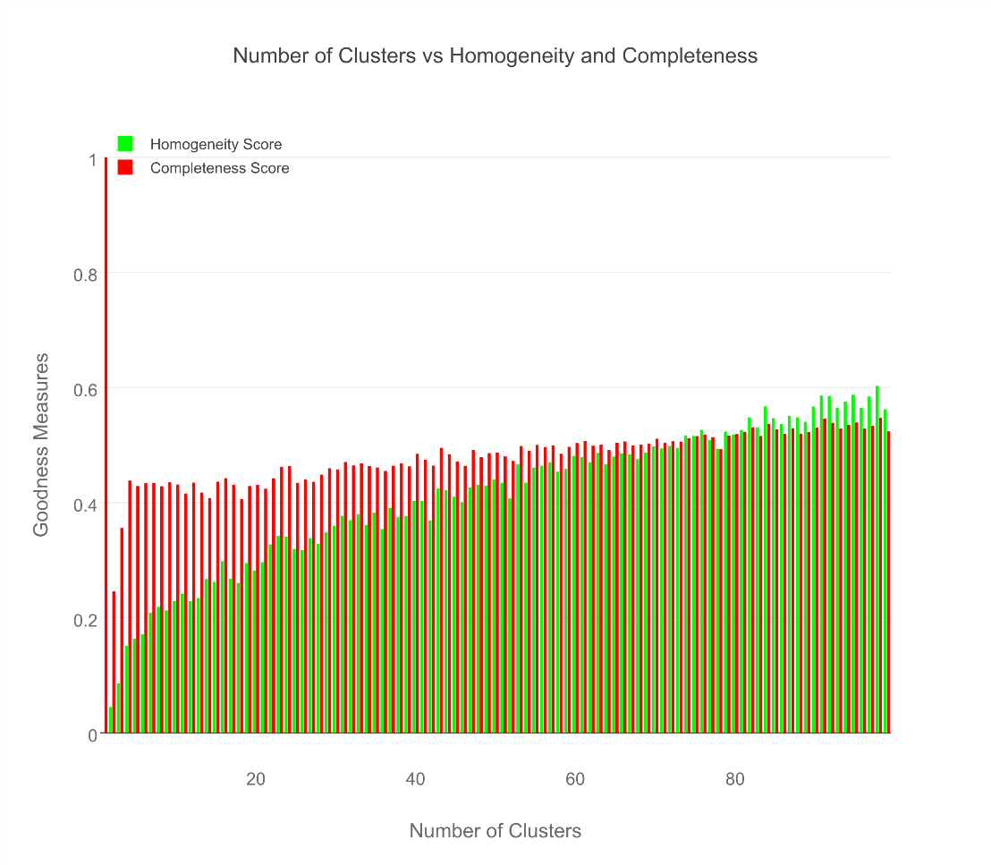
External measures

Slide 12
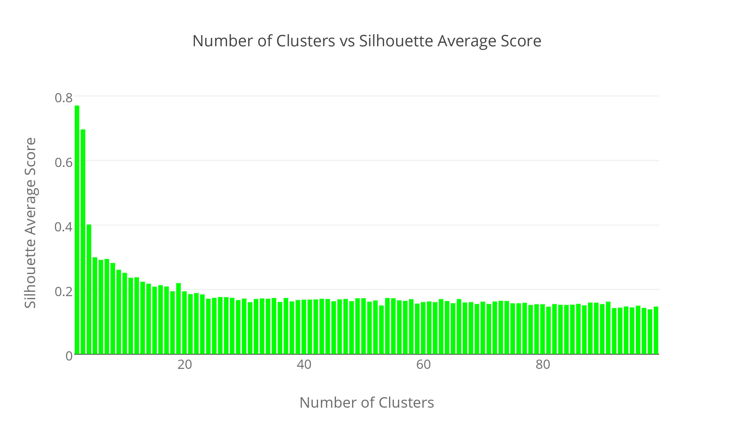
Internal measures – Euclidean

Slide 13
Internal measures – Manhattan

Slide 14
Results for Medical & Healthcare Apps
AppPkgName | Cluster Assignment | AppCategory
com.fitnow.loseit | 13 | Health & Fitness
com.webmd.android | 13 | Health & Fitness
com.drugscom.app | 13 | Medical
com.ovuline.pregnancy | 13 | Medical
air.com.peppapig.paintbox | 13 | Educational
com.t11.skyviewfree | 13 | Education
gov.nasa | 13 | Education
com.google.android.stardroid | 13 | Books & Reference
com.turner.cnvideoapp | 13 | Media & Video
com.nextradioapp.nextradio | 13 | Music & Audio
com.camerasideas.instashot | 13 | Photography
com.foxsports.videogo | 13 | Sports
com.theopen | 13 | Sports
com.tregware.radar | 13 | Weather

Slide 15
Results for All Medical Apps
AppPkgName | Cluster Assignment | AppCategory
com.drugscom.app | 13 | Medical
com.ovuline.pregnancy | 13 | Medical
com.jardogs.fmhmobile | 14 | Medical
com.goodrx | 49 | Medical
com.microphone.earspy | 65 | Medical
com.hp.pregnancy.lite | 75 | Medical
com.carezone.caredroid.careapp.medications | 80 | Medical
com.smsrobot.period | 94 | Medical
epic.mychart.android | 96 | Medical

Slide 16
Results for All Health & Fitness Apps
AppPkgName | Cluster Assignment | AppCategory
com.fitnow.loseit | 13 | Health & Fitness
com.webmd.android | 13 | Health & Fitness
com.period.tracker.lite | 27 | Health & Fitness
com.popularapp.periodcalendar | 27 | Health & Fitness
com.cvs.launchers.cvs | 32 | Health & Fitness
com.babycenter.pregnancytracker | 54 | Health & Fitness
com.fitbit.FitbitMobile | 60 | Health & Fitness
com.myfitnesspal.android | 87 | Health & Fitness
com.google.android.apps.fitness | 91 | Health & Fitness
com.tayu.tau.pedometer | 94 | Health & Fitness

Slide 17
Finance apps seem to pretty uniform
AppPkgName | Cluster Assignment | AppCategory
com.google.android.apps.walletnfcrel | 31 | Finance
com.infonow.bofa | 31 | Finance
com.paypal.android.p2pmobile | 31 | Finance
com.geico.mobile | 32 | Finance
com.creditkarma.mobile | 57 | Finance
com.acorns.android | 58 | Finance
com.chase.sig.android | 58 | Finance
com.venmo | 58 | Finance
com.wf.wellsfargomobile | 58 | Finance

Slide 18
Library Apps seem like the best
AppPkgName | Cluster Assignment | AppCategory
com.aviary.android.feather.plugins.borders.free | 5 | Libraries & Demo
com.aviary.android.feather.plugins.filters.original | 5 | Libraries & Demo
com.aviary.android.feather.plugins.stickers.free_stickers | 5 | Libraries & Demo
com.estrongs.chromecast | 5 | Libraries & Demo
com.foxfi.addon | 5 | Libraries & Demo
com.mxtech.ffmpeg.v7_neon | 5 | Libraries & Demo
com.mxtech.ffmpeg.v7_vfpv3d16 | 5 | Libraries & Demo
com.google.samples.apps.cardboarddemo | 27 | Libraries & Demo
com.google.vr.cardboard.apps.designlab | 27 | Libraries & Demo
com.ivona.tts | 65 | Libraries & Demo

Slide 19
What did we see in cluster 5?
read phone status and identity, full network access
read sensitive log data, full network access
find accounts on the device, control vibration, run at startup, read Google service configuration, full network access
modify or delete the contents of your USB storage, read the contents of your USB storage, Wi-Fi connection information, view Wi-Fi connections, Google Play license check, full network access, prevent device from sleeping, view network connections
precise location (GPS and network-based), draw over other apps

Slide 20
Spectral Clustering
Using Weighted Jaccard Similarity Metric

Slide 21


Spectral: Process
Step 1: Compute weights for all app permissions found using a IDF function.
Step 2: Create vector of permissions for each app.
Step 3: For each app pair compute Weighted Jaccard Similarity metric as below:
Step 4: Use the computed similarity metric as an input the Spectral Clustering
$$W\left(p\right)\text{p}\text{∈}\text{perm}\text{set}=\frac{\text{∑} total number of apps}{\text{∑}\text{apps} \text{requesting} \text{permission} \text{p}}$$
$$JS\left(x,y\right)\text{x}\text{,}\text{y}\text{∈}\text{appset}\text{,}\text{x}\text{≠}\text{y}=\frac{\text{∑}\text{WeightOfPerm}\text{(}\text{permSet}\text{(}\text{x}\text{)∩}\text{perSet}\text{(}\text{y}\text{))}}{\text{∑}\text{WeightOfPerm}\text{(}\text{permSet}\text{(}\text{x}\text{)∪}\text{perSet}\text{(}\text{y}\text{))}}$$

Slide 22
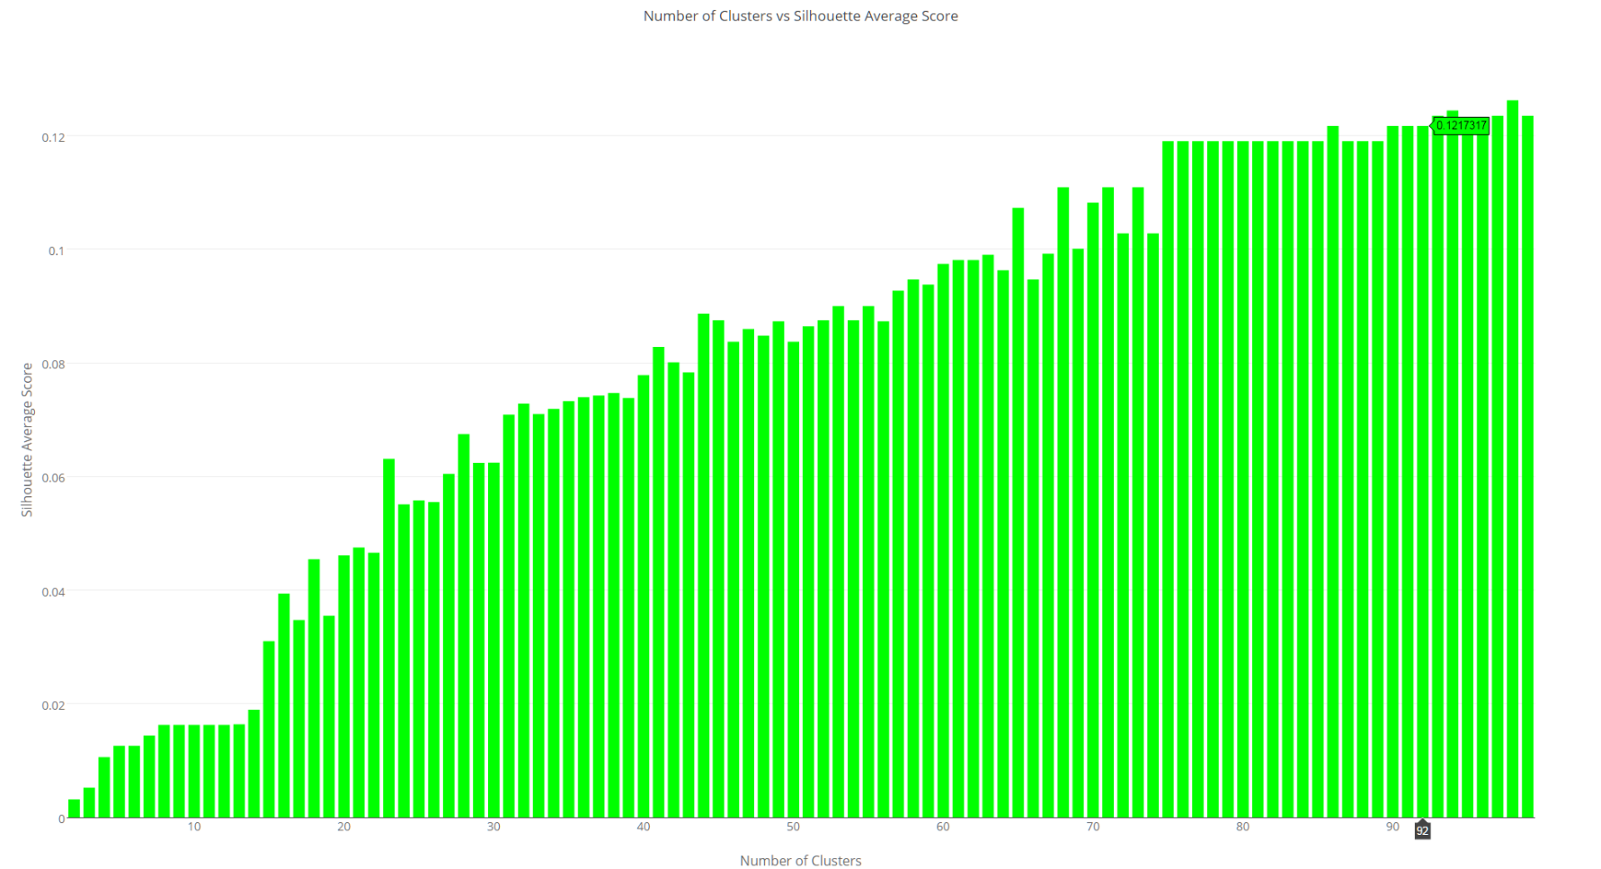
Internal Measures – Jaccard Similarity

Slide 23
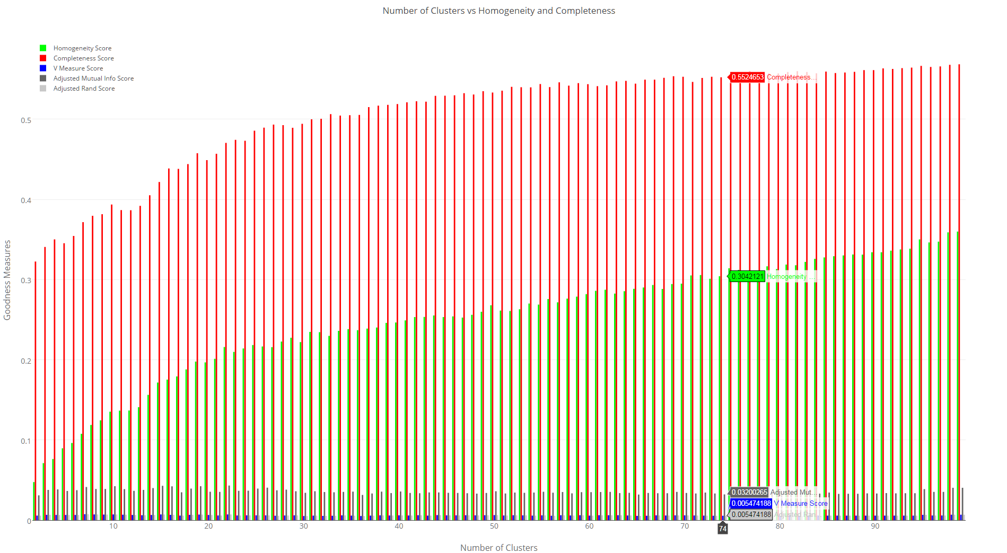
Internal Measures – Jaccard Similarity

Slide 24
Future work
In Clusters manually annotate apps which are “weird”
Run SVM classifiers with more info on these apps like download count and ratings
Use TF-IDF on description
Use web data for app info

